Slide 1
RNN & LSTM
Fundamentals of the voting process

Slide 2

Why previous states / input is important

Slide 3
Why previous states / input is important

Slide 4
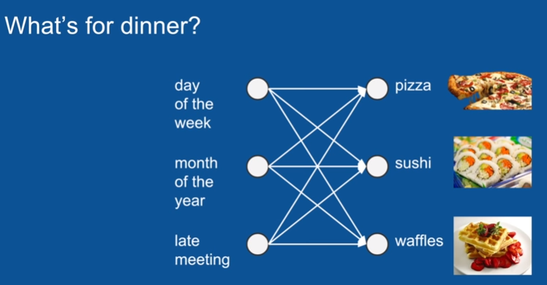
Sequence

Slide 5
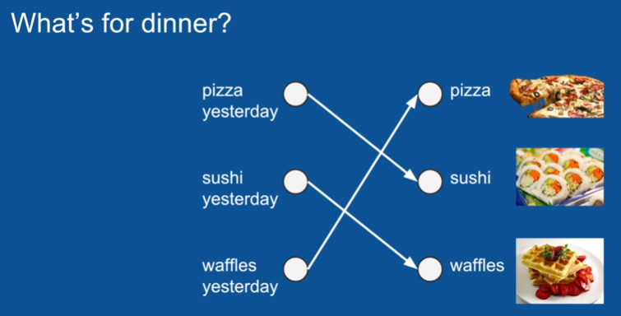
Better Sequence

Slide 6
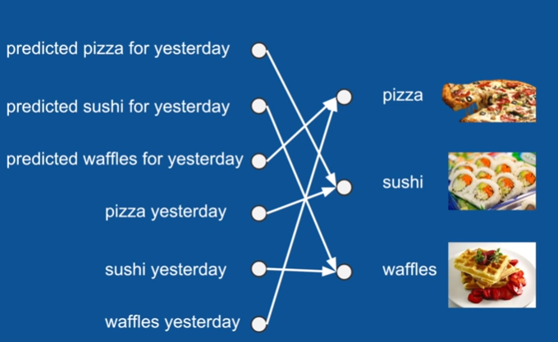
Missing Sequence

Slide 7
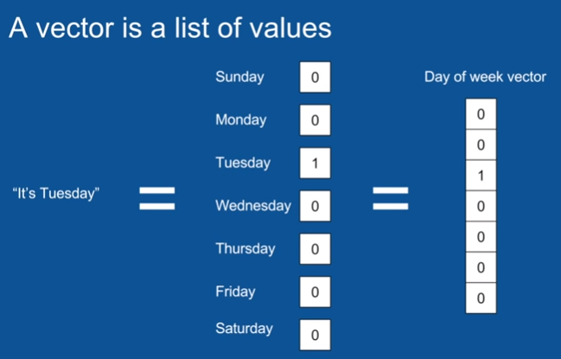
Vectors

Slide 8
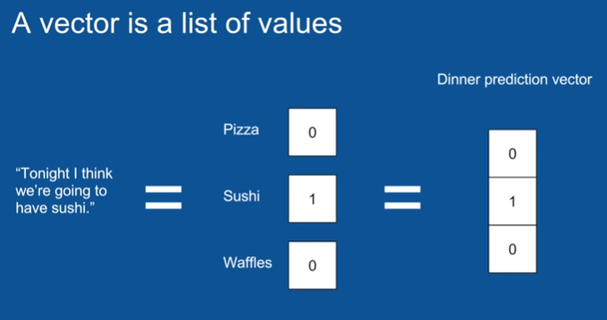
Vector for Dinner

Slide 9

Vector for Dinner

Slide 10
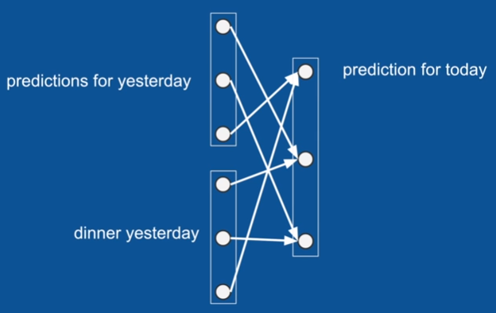
Vector Groupings

Slide 11
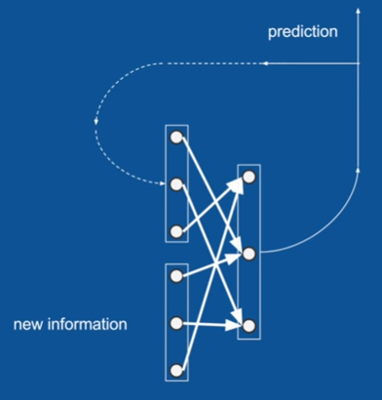
RNN

Slide 12
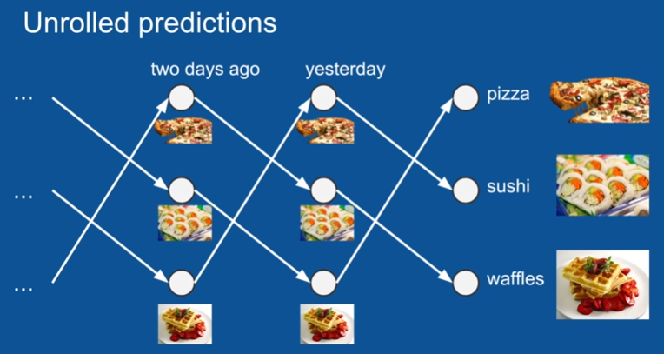
RNNs Unwrapped

Slide 13
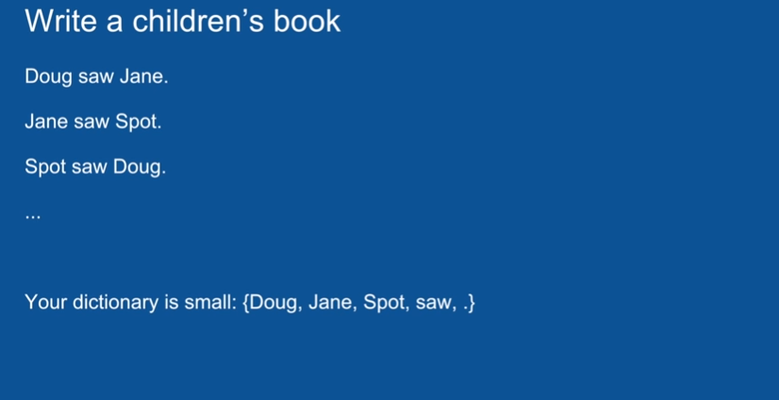
Writing a book

Slide 14

Vectors for Book

Slide 15
Vectors for Book
0
1
0
0
0

Slide 16

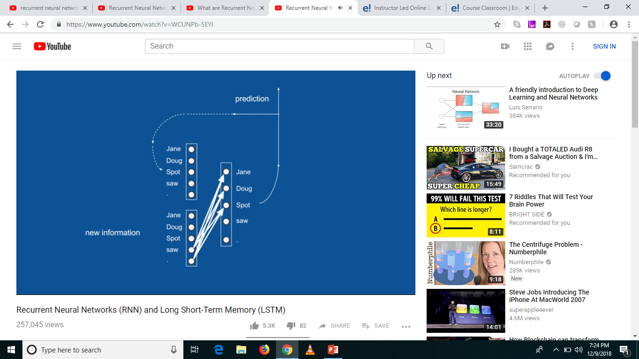
After Training

Slide 17

What does RNN look like?
Activation Function

Slide 18
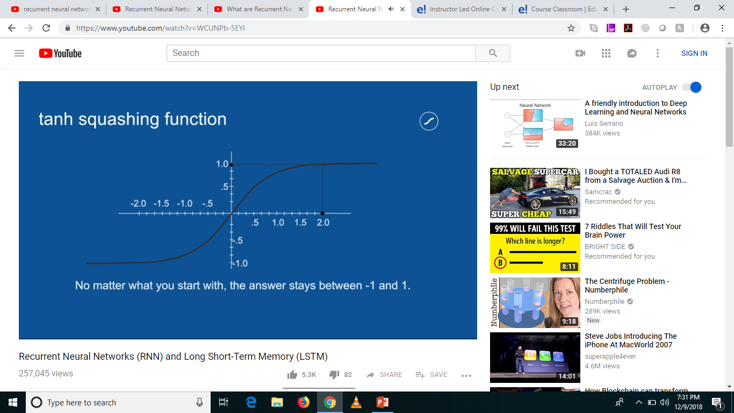
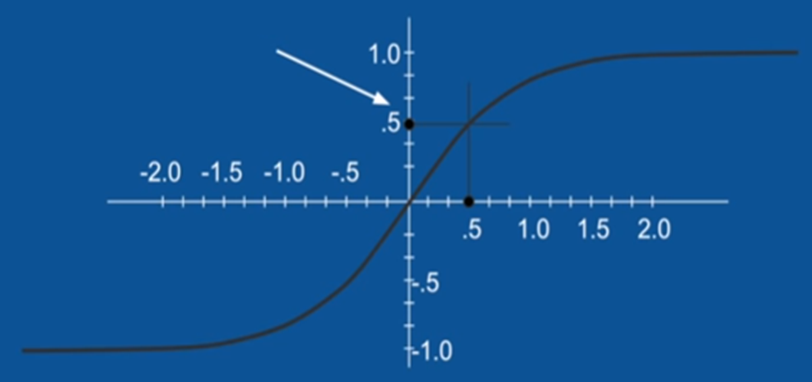


tanh – Activation Function

Slide 19
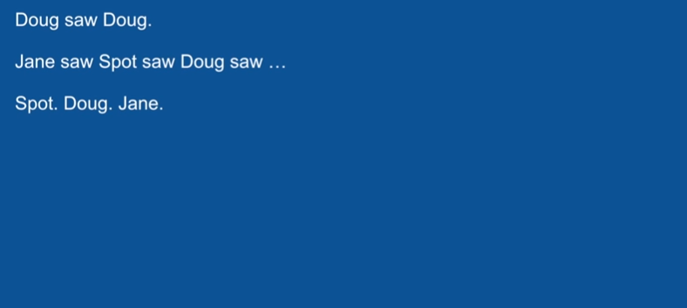
Mistakes with RNN

Slide 20
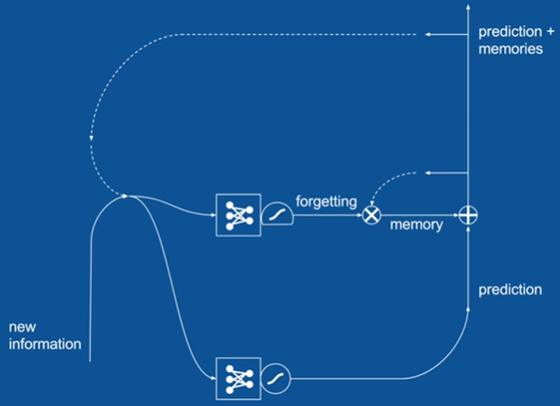
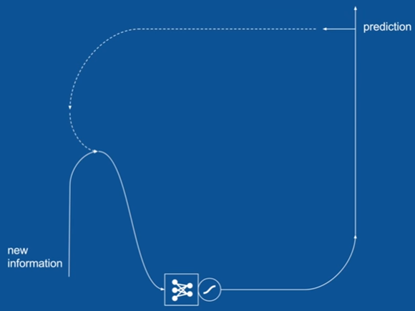

The Solution
Addition
Junction
Multiplication
Junction
Activation Function

Slide 21
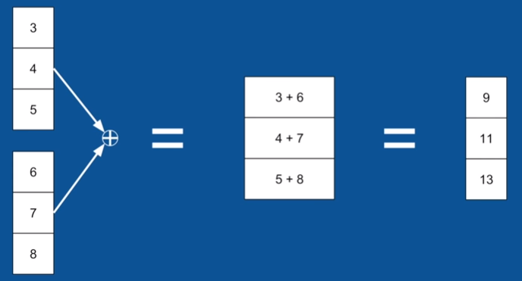
Addition Junction (element by element)

Slide 22
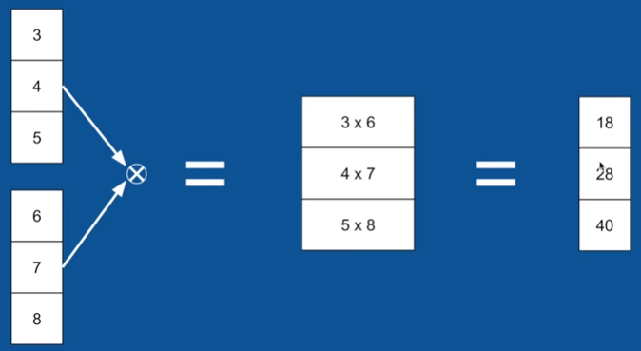
Multiplication Junction (element by element)

Slide 23
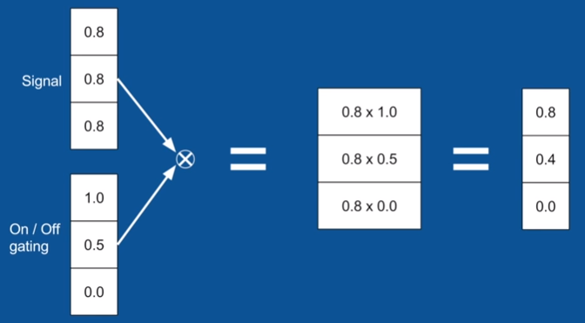
Multiplication Junction (element by element) Example

Slide 24

Logistic Function

Slide 25
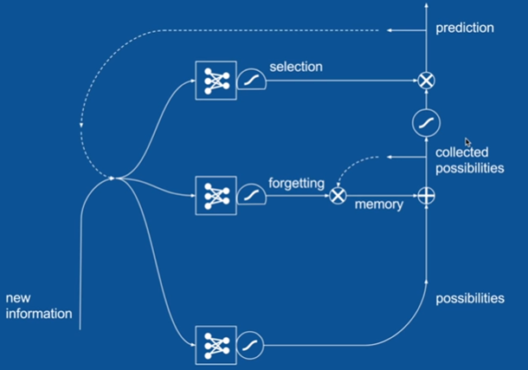
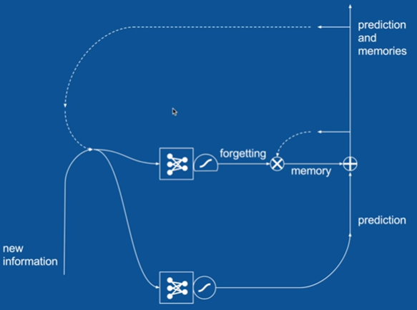
Our RNN becomes LSTM

Slide 26
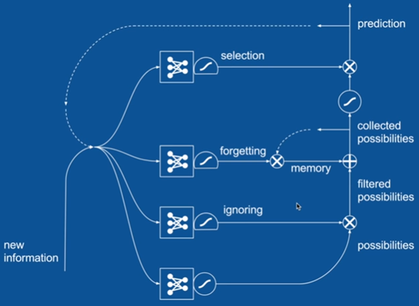
Complete LSTM

Slide 27
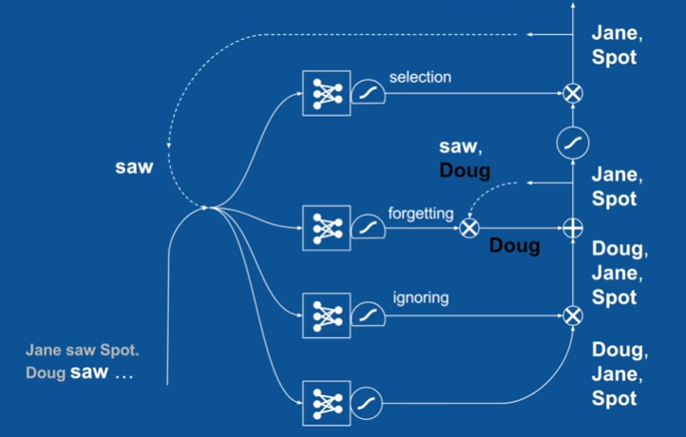
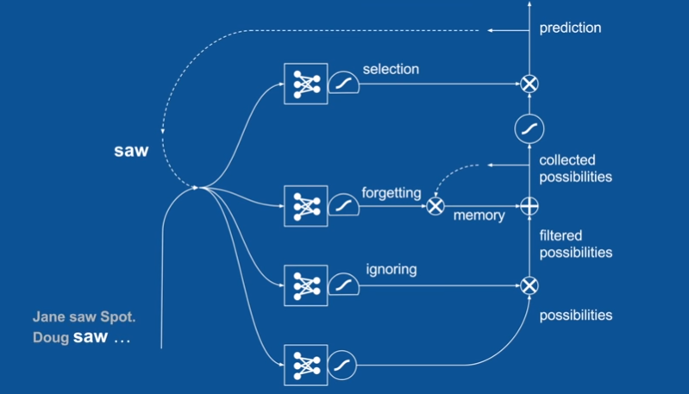
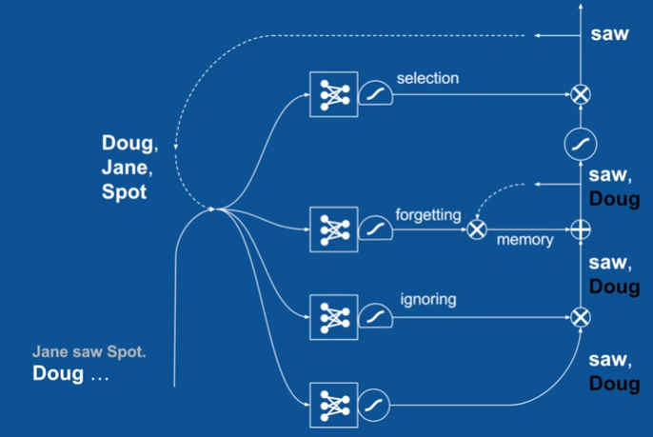
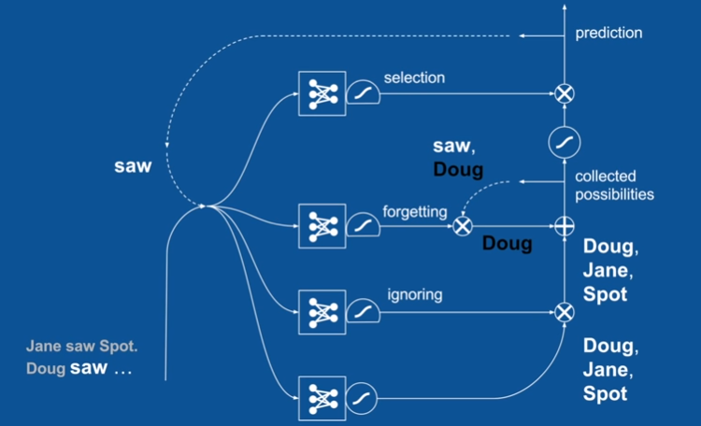
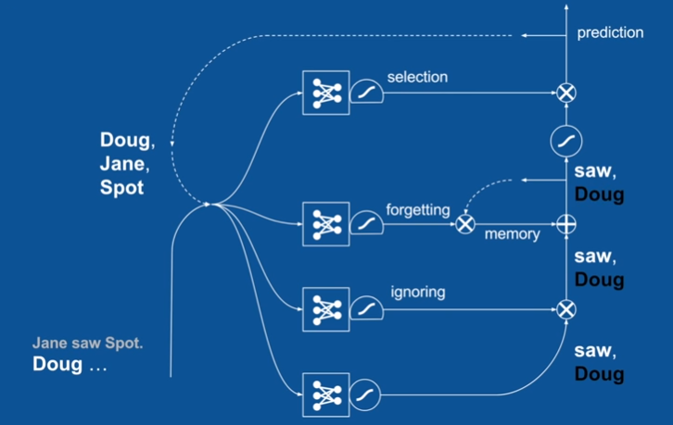
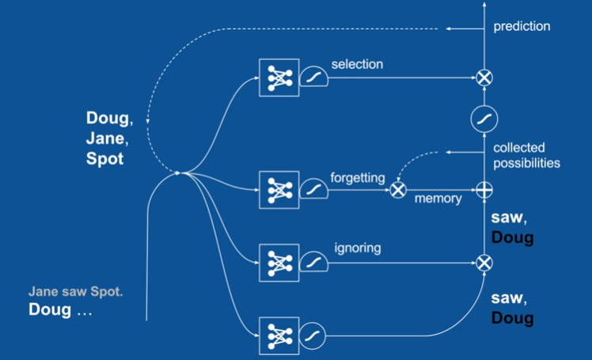
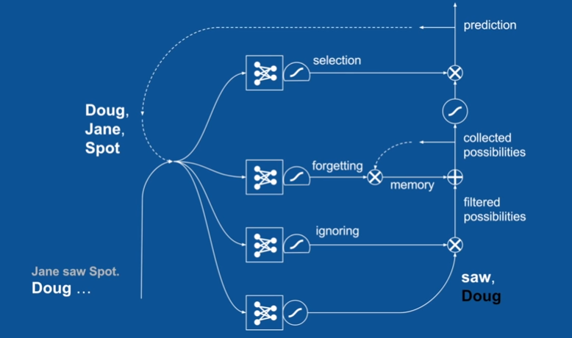
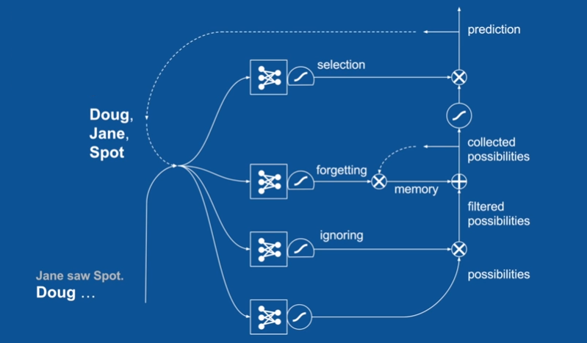
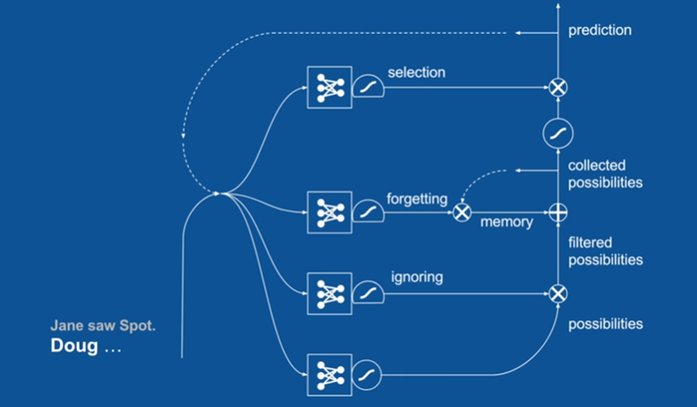
Example – Book

Slide 28
Applications for LSTM
Text (Generation, Translation)
Speech (Translation from Speech to Text and vice versa)
Audio
Video
Robotics (Decision making based on various inputs)

Slide 29
Questions?
Thank you!

